Slide 1

Client Success Report – Nov’25
Internal Only

Slide 2


Account Overview & Adoption
Vertical | Support Tier | Renewal
BFSI | ES | 06-Dec-2026
Key Artefacts (include links) | Date | Owner
Account Plan (First Draft) | 15-Mar-25 | AE
Success Plan (First Draft) | 31-Mar-25 | CDL/APA/TAM
Next QBR | TBD | AE
Previous QBR | 26-Nov-25 | AE
Year | ARR | PP/ES Subscription ARR
2021 | $1.73M | $233K
2022 | $2.13M | $233K
2023 | $2.58M | $233K
2024 | $1.76M | $ 200K
2025 | $1.95M | $ 200K
2026 | $3.05M | $250K
Exec Asks
Coverage | None
Investment | None
Escalations | None
Name | Role | Location
Chris Gray / Udit Jain | Account Executive | UK / India
Priyesh Tiwari | Technical Account Manager | India
Surabhi Gavali | Customer Success Manager | UK
Jeremy Brown | Pre Sales Engineer | UK
Account Team

Slide 3
Product Adoption Data
Type | Elements | Products | Unit | Usage
Core Products | Robots | Unattended Robot | 550+10% | 100%
 |  | Test Robot | 100 | 60%
 | Users | Action Center User | 1700 | Not in use
 |  | Attended User
 |  | Automation Developer
 |  | Citizen Developer |  | Not in use
 |  | Process Mining User |  | Not in use
 |  | Tester User |  | Not in use
Complimentary Product Pack Available for Small Production, Pilot, Evaluation & POC Initiatives
Packaged Products | Platform | Automation Hub | 1 | Not in use
 |  | High Availability | 1 | 100%
 |  | Insights | 1 | Not in use
 |  | Test Management | 1 | Set up Completed
 | Consumables | AI Units 60K | 4 | Not in use
 |  | API Calls 6M | 1 | Not in use
 |  | Process Mining Rows -20M | 2 | Not in use
 |  | Robot Unit Bundle | 1 | Not in use
Key Points
550 + 10% buffer included as part of the agreement.
Current usage concern:
  1,000 out of 1,700 licenses in use (59% utilization)
Risk Mitigation Actions:
  Deployment of Forward Deployed Engineers (agreed to, not engaged/deployed as yet)
  Account-Based Marketing (ABM) initiatives
  Hands-on Training & Learning Sessions
  SWAP rights
  All measures available for future UiPath investment
59%
3

Slide 4


CSM: Surabhi Gavali
TAM: Priyesh Tiwari
Usage
70%
Health Score
83%
Green
Account Team Sentiment RAG
Key Updates – Nov’25
Upcoming Key Activities – Dec'25
1. Agentic & AI-led Automation
Started assessment for the Mandate process in BUK, helping identify high-value agentic automation opportunities that can reduce manual workload and compliance risk.
Conducted a F2F workshop on agentic capabilities, accelerating adoption readiness and improving stakeholder confidence to scale agentic automation.
Engaged Corporate Payments team and shared agentic artifacts, opening new automation opportunities across payment operations and expanding cross-LOB pipeline.
Proposed an Agentic Hands-on Workshop, enabling teams with practical skills that directly increase adoption and platform usage.
2. Platform Efficiency & Governance
Coordinated AWS Bedrock Integration, ensuring enterprise-grade LLM readiness and strengthening future AI scalability.
Completed Cloud IP configuration updates, enhancing secure connectivity and ensuring compliance with Barclays network governance.
Conducted QBR with CTO Org, aligning strategy and securing continued executive sponsorship for ongoing platform expansion.
Deployed Test Manager & Action Center to strengthen end-to-end test automation capabilities; HITL and improve quality assurance governance.
3. Ecosystem Collaboration & Pipeline Growth
Collaborated with BUK, Corporate Payments & CTO stakeholders, driving cross-functional alignment and expanding the automation pipeline across business and IT.
1. Platform Modernization & Upgrades
Upgrade UiPath Studio & Robots to version 24.10.x (latest available) to ensure compatibility, performance improvement, and access to new features.
Perform tests on the cloud migration tools to identify any potential issues in advance and prepare the necessary resolutions prior to the actual migration
Enable seamless version control and CI/CD automation through GitLab integration with UiPath Cloud.
2. Enablement & Adoption Acceleration
Collaborate with business and CoE teams to identify priority agentic use cases and initiate pilot PoCs to demonstrate measurable business value.
Establish integration between Barclays AWS Bedrock and UiPath Cloud via Integration Service Connector to explore GenAI-driven automation opportunities.
3. Platform Governance
Define and implement Role-Based Access Control and governance framework to ensure secure and compliant operations on UiPath Automation Cloud.

Slide 5


Program and Communication Governance
Meeting | Recurrence | Topic | Participants
Technical Platform check-in | Bi-weekly | Platform updates Migration strategy InfoSec engagements | Barclays Group: Pankaj UiPath: TAM, APA, CDL, Pre-Sales
Program Execution Check-in | Bi-weekly | Cloud Migration BP to UiPath migration Automation Roadmap ACP program | Barclays Group: Sundar, Pankaj, Bhupi UiPath: Account Team
Technical Check-in | Weekly | Workstream status and progress​ Platform readiness Plan next steps/ activities Technical best practices | Barclays Group: Nilanshu, Abhijeet & Ayaz UiPath: TAM (primary), CDL
COE’s Check-In | Monthly (yet to align) | Connect on current progress Discuss on support needed Design & Solution Review | Barclays Group: Federated COE Leads UiPath: TAM, APA, CDL (optional – AE)
Customer Value Review/QBR | Quarterly/ Tertiary | Strategic lookback around realized value Go-forward roadmap for success | Barclays Group: Sundar, Pankaj, Bhupi, Federated COE leads UiPath: Account Team
Alignment
Barclays Group
Executives
UiPath
Executives
Executive Committee
Sponsors,
CoE Owners
Account Executive, CDL, TAM, APA
Operating Committee
Platform, Central COE,
Automation Architects,
Developers
TAM
Program Execution
Client Delivery Lead Accountable for all delivery activities
Other Alignments
1. BP to UiPath migration – Accenture, Capgemini
2. ACP program - Accenture

Slide 6
Automation Journey with UiPath
2024
Renewed to ES (3 + 3 year deal)
Federated 3-year
Cloud service validations
UiPath Cloud Migration Decision
Unattended processes & bot rollout
2025
Cloud Migration
Platform upgrade to v23.10
Task Mining PoCs & adoption
BP to UiPath migration (300+ processes/1600 unattended bots)
PoC on Communication mining, Test Suite & Gen-AI Capabilities
Insights Adoption
Attended process for contact center (user base as 4K)
2020-22
Large landscape of BP
Introduction of UiPath
Processes to cater customer care agents via attended bots
Low adoption
2023
Centralized COE
Platform stabilization
Orchestrator upgrade (22.10)
Studio/Robot upgrade (22.10)
Unattended Bot e2e validation
(35 Attended Processes with ~500 users)

Slide 7
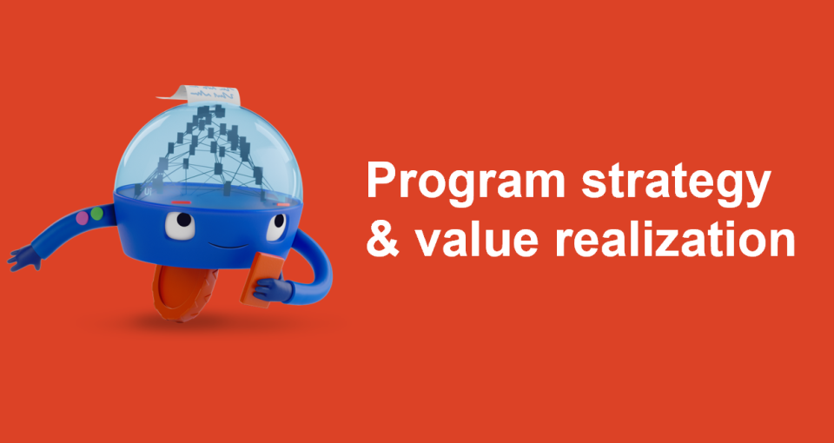
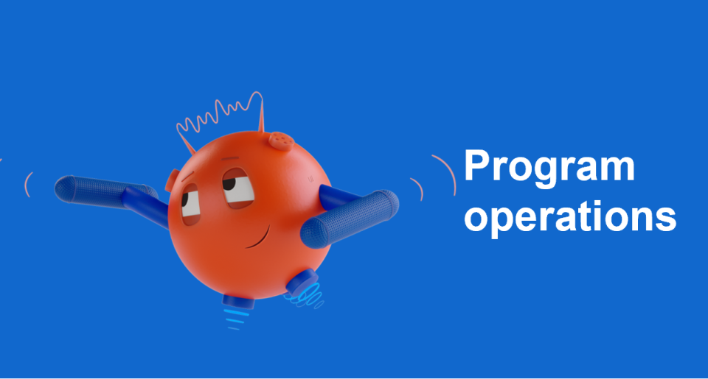
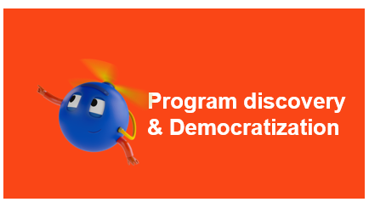

Barclays – ES Engagement Deliverables
Deliverables
Delivered
Guidance and support on UiPath Automation Cloud offerings and features to scale up the platform.
Advisory on product roadmap.
Advisory on best practice of folder structure, organization & tenant management.
HAA Set up for production (active-active set up).
Validation Testing for UiPath Cloud platform in Barclays environment.
Provided solution for user-based license clean to achieve accurate adoption and plan better utilization.
Creation of code-reusable artifacts.
Advisory on insights capabilities.
Advisory on use case feasibility check available in the pipeline
Quarterly f2f meetings with Barclays stakeholders.
In-Progress
Advisory on license distribution.
Advisory on Product capability and sessions on new product version releases.
Orchestrator upgrade to version 23.10 in Dev.
Platform Testing to ensure smooth scalability.
UiPath Cloud security review.
Task mining sessions to derive automation pipeline.
Automation Program success planning.
Weekly connects for technical platform and design/code related queries.
Plans
Automation program value definition
Value management advisory
Adoption for 4K attended licenses under contact center processes.
Orchestrator upgrade to version 23.10 in UAT and Prod.
Migration from on-prem to UiPath cloud.
Support on BP to UiPath migration.
CI/CD set up with UiPath automation cloud feature.
Adoption for Action Center & Insights
Training for 1000+ users on UiPath.
DU and Communication mining sessions.
Program health assessment.
Updates to ES success plan based on objective for 2025.

Slide 8
